Slide 1
AI Automated checkout
Luke Herbst
Final Machine learning Project
Coderschool VN

Slide 2
What is does ?
Customer info
Load into database
Place items
Take video +
Object detection
Pay
Database update
Inputs->
Process ->

Slide 3
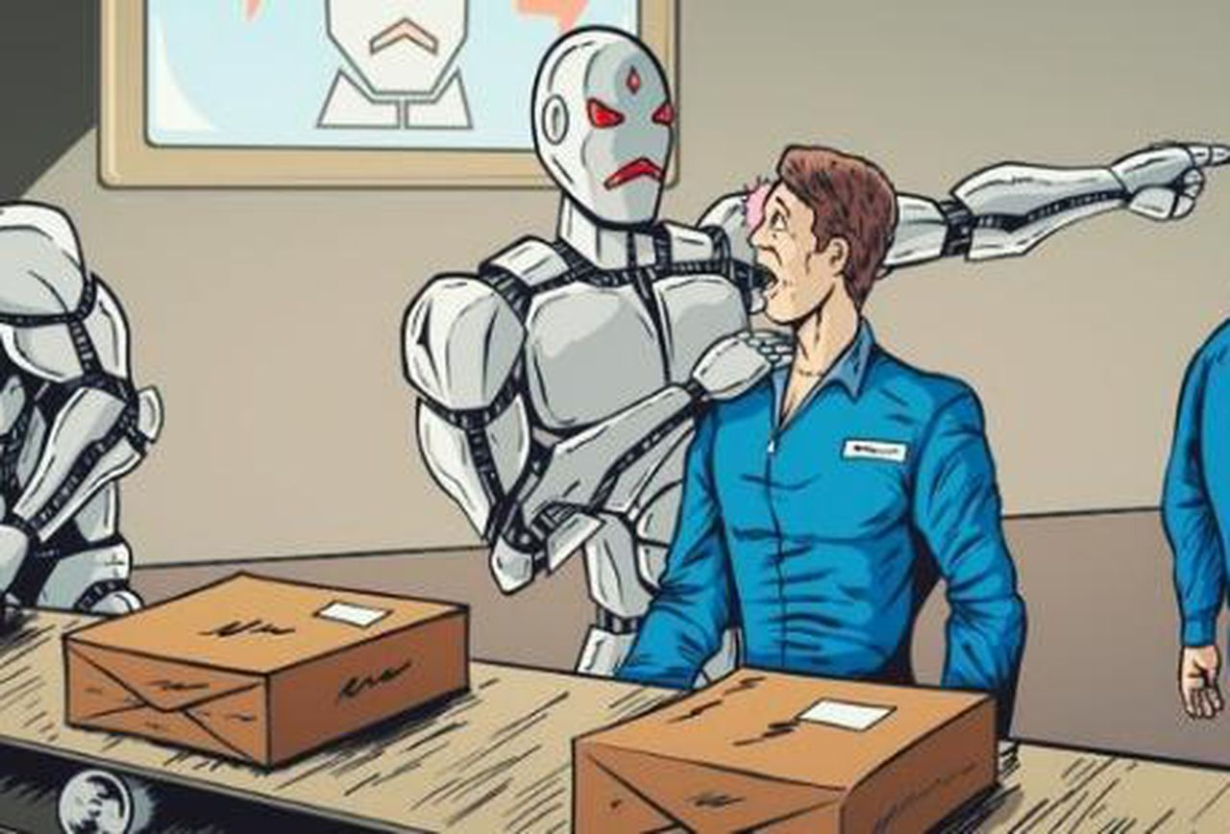
Why ?
Computers doing the jobs that humans would usually do, reducing costs to the company in the long run.

Slide 4
How ?

Slide 5
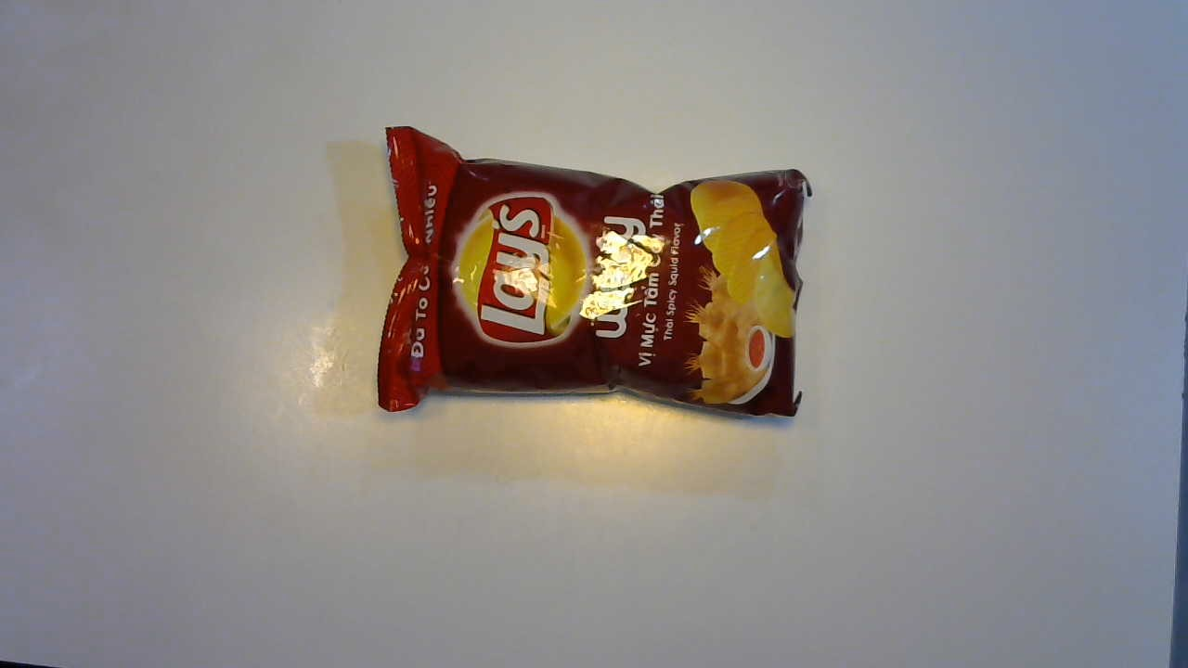
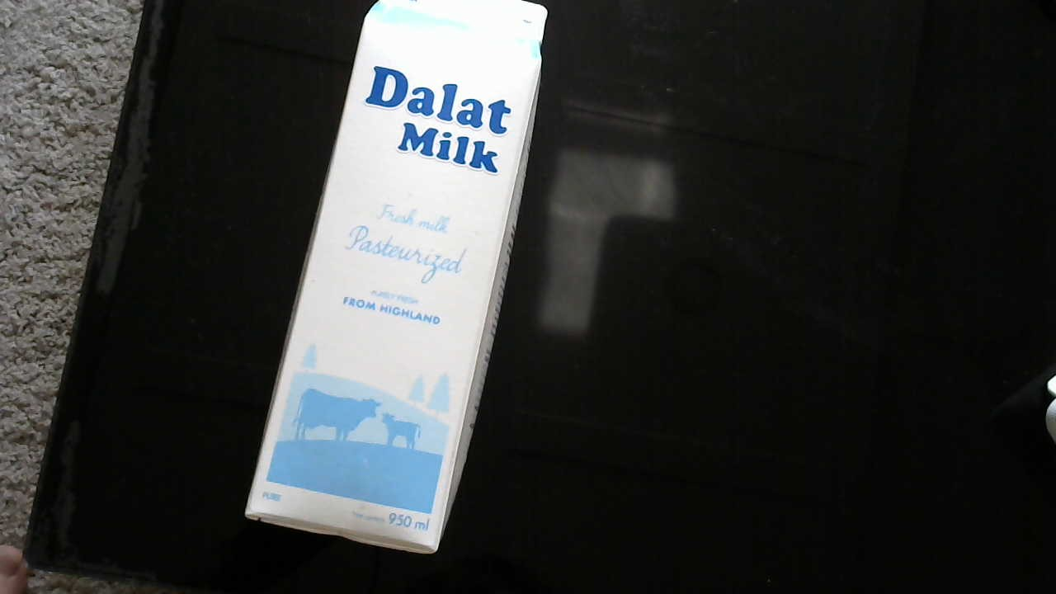
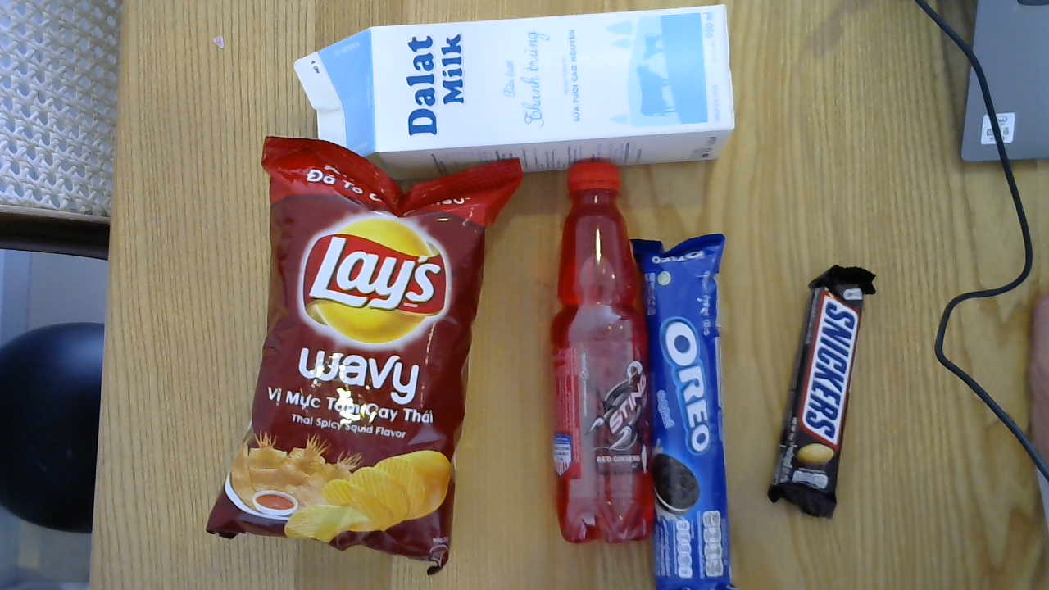
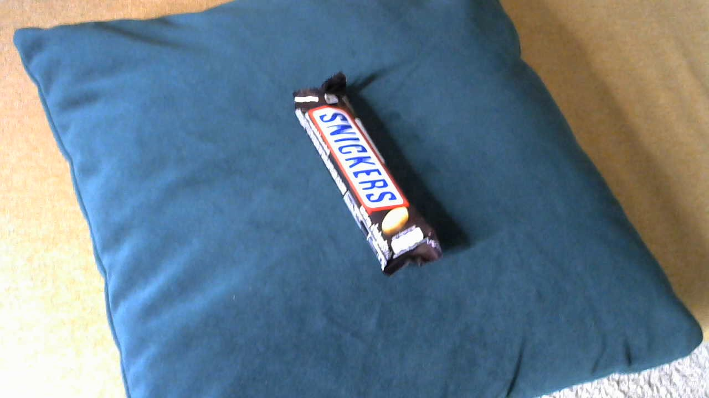
The DATA !!!!

Slide 6
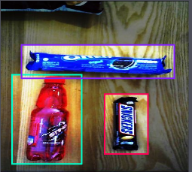
Data preprocessing
500 images
Draw bounding boxes
Label boxes
Resize images
I used Roboflow to help get the data into the correct format

Slide 7
Technical Side
custom yolov4 model
OpenCV
Sqlite3

Slide 8
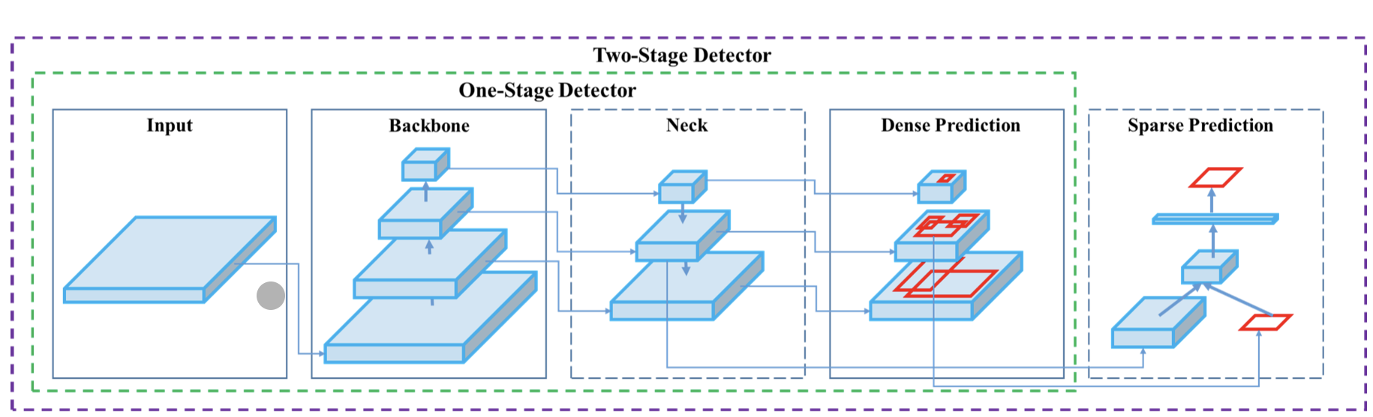
Yolo object detection
CSPDARKNET53 PANET Layers 86, 96,106
Source: https://becominghuman.ai/explaining-yolov4-a-one-stage-detector

Slide 9
Yolo continued..
Input :416 x 416
Yolo detection layers
13x13 = 507 boxes
26x26 = 2028 boxes
52x52 = 8112 boxes

Slide 10
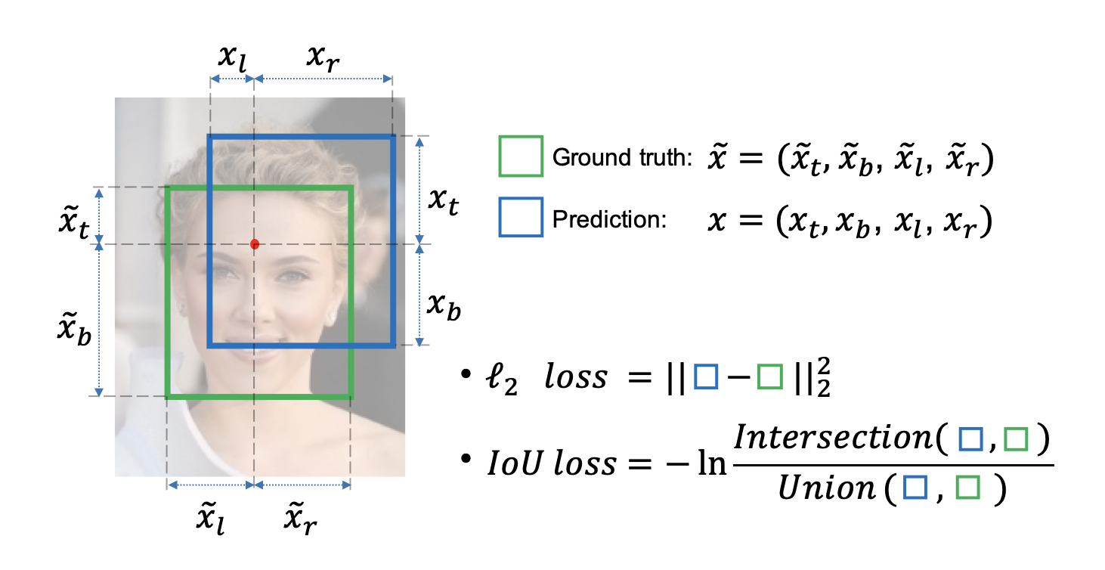
Loss function
Yolo outputs

Slide 11
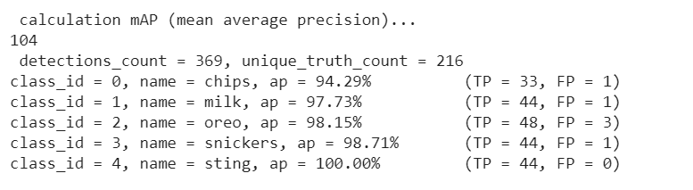
Training results

Slide 12
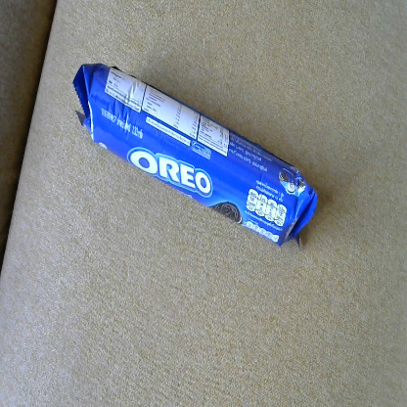
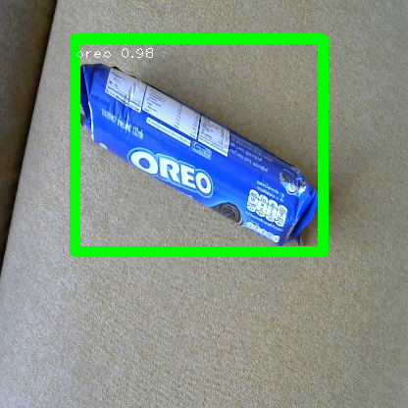
OpenCV
yolo
1.Loop through the boxes
2. If Probability of class n is > threshold keep the box
3. Non-max suppression on remaining boxes
4. draw the boxes and write the label

Slide 13
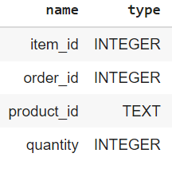
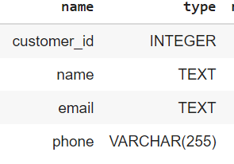
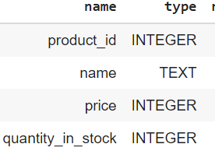
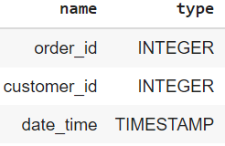
Order items
customers
products
Orders

Slide 14
DEMO TIME

Slide 15
References
Roboflow website - https://roboflow.com/
Yolov4 - https://arxiv.org/abs/2004.10934

Slide 16
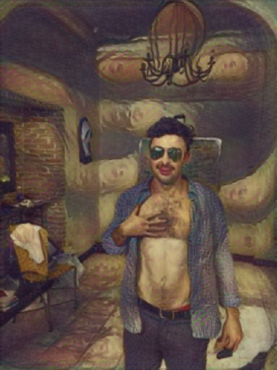
Thanks

